Slide 1

MSME Kart Enterprise Application

Slide 2

PROJECT REPORT
MSMEKart ENTERPRISE APPLICATION
Submitted By: -
Under the guidance of
NAME | ROLL-NO | SAP-ID
Utsav Bhardwaj | R163217011 | 500063056
Bhavesh Joshi | R163217001 | 500062435
Sehajpreet Boparai | R163217007 | 500062448
Under the guidance of
Dr. Durgansh Sharma
School of Computer Science and Engineering
SCHOOL OF COMPUTER SCIENCE
UNIVERSITY OF PETROLEUM & ENERGY STUDIES
Bidholi Campus, Energy Acres, Dehradun – 248007.

Slide 3
Introduction The Enterprise Application suggested is a Business to Business Application, named MSMEKart. It’ll be a native Android Application. It is basically an E-commerce application at an enterprise level. It is a Business to Business application. Users can find the particular commodities at MSMEs of the particular area through this app. The Company staff will be notified via push notifications at various steps, such as shipment. We tend to implement to increase reach of local retailers to customers We will implement various support mechanism like authentication customer care. Some of the basic features, to be used in the application itself, are: Authentication Push Notifications Complaint service Payment Gateway Database storage and retrieval

Slide 4
Methodology
The methodology which we are using is Agile Development. This method is an iterative and incremental method in this complete development of the app will be dived into sub modules and those modules will be considered as small project in itself

Slide 5
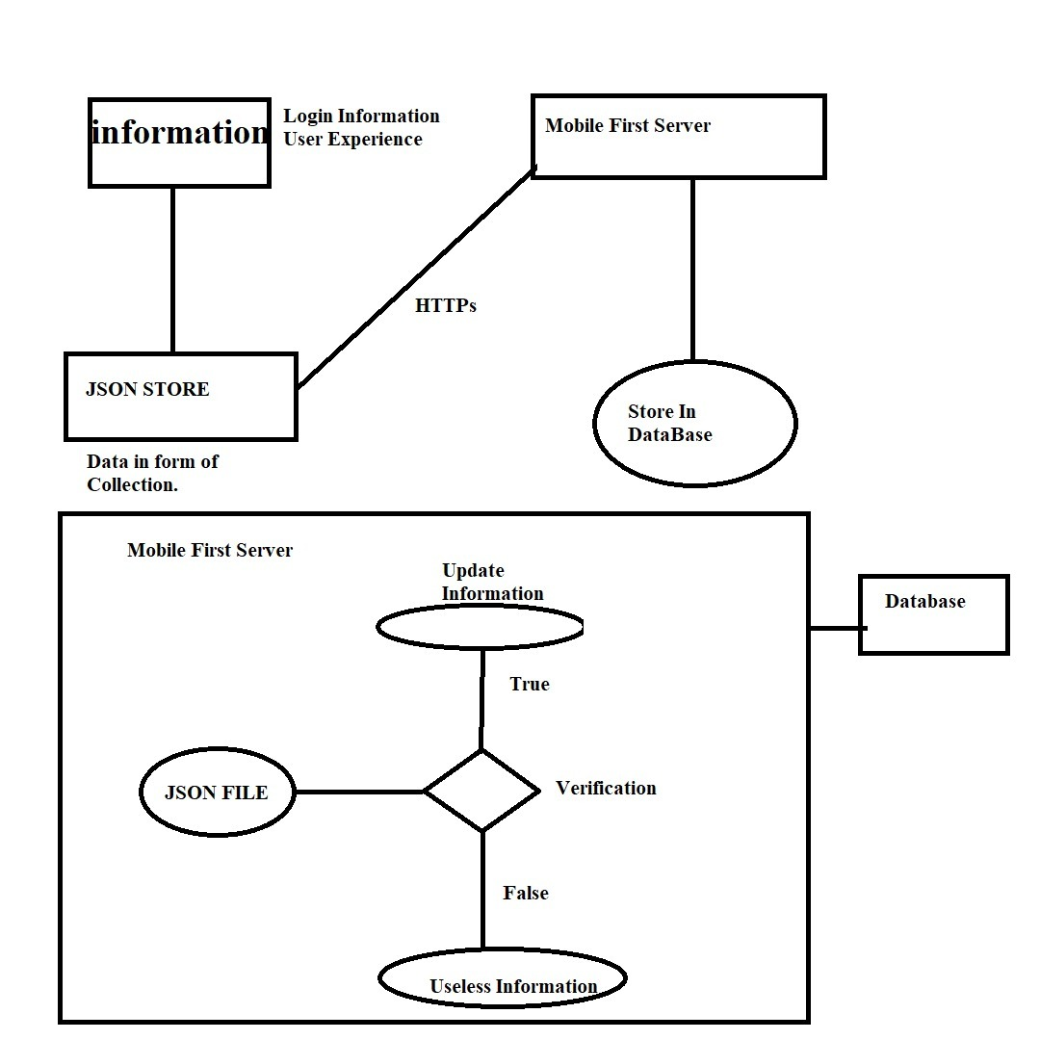
Architecture

Slide 6
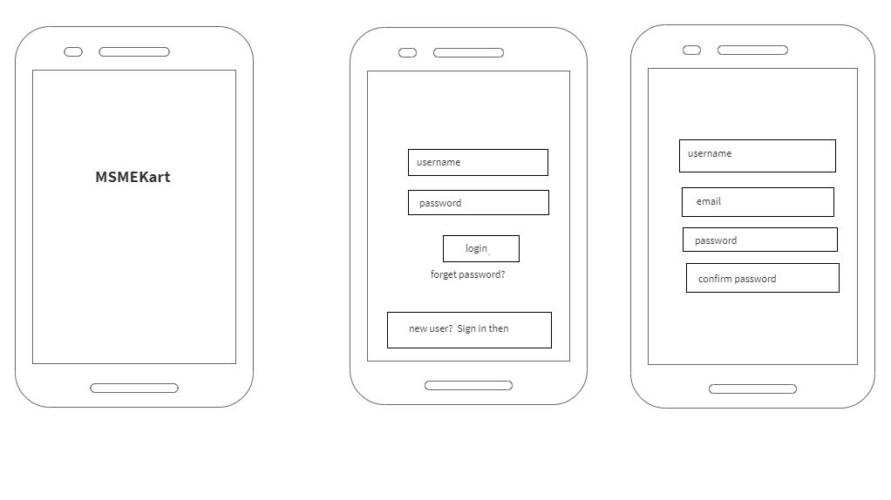
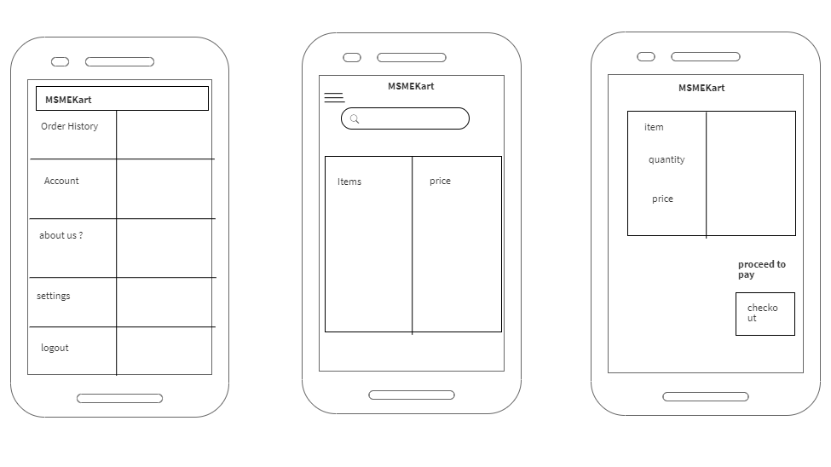
Wireframe of the project: -

Slide 7
Above are the wireframes of the project proposed.
Screen1 It is a splash screen with the logo of the Application, which will be displayed for a few seconds.
Screen2 The next screen will be taking some input from the user i.e. his/her phone number for authentication. It is an Outhbased authentication; the user will receive an Outh to log into his/her account. Here, the user enters his/her phone number and clicks proceed to jump to the next screen.
Screen3 Now, the next screen is for those who are using it for the first time and they are here for the signup.
Screen4
This the screen where user will find out about his account, settings and about the developers of the MSMEKart. He or she can logout through the account with this.
Screen5 Home screen of the app where user will search for accessories exposure through the local MSMEs of his area through our app and user can have his/her order history regarding to the past transactions.
Screen6 this is the screen where user will actually selects his/her certain items with certain quantity and will be ready to checkout with it.
A confirmation mail will be sent to the user about the order he or she has been placed.

Slide 8
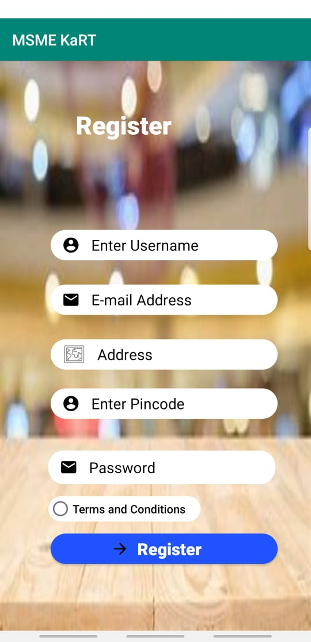
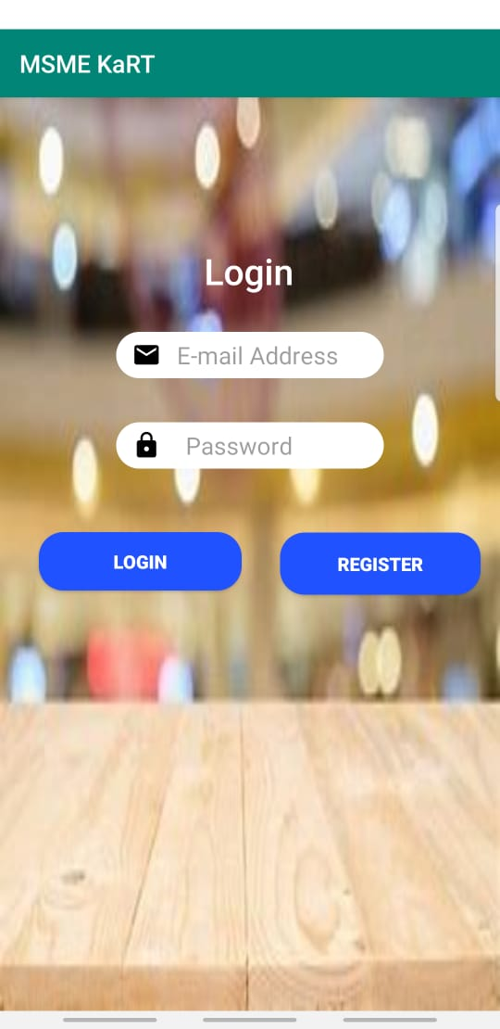
This is the Implementation of the Register Activity & Login Activity. Before users can register an account, they must fill out the fields shown in the activity, if they leave the fields blank or enter incorrect data then they will get presented with errors . After all the fields are entered will correct data, the registration data will get stored in a Firebase Database. The user will log in with their registered account, if they enter the wrong credentials then they will receive an error saying that the details are incorrect. If the credentials entered are correct and match the database, then they are taken back to the homepage.

Slide 9
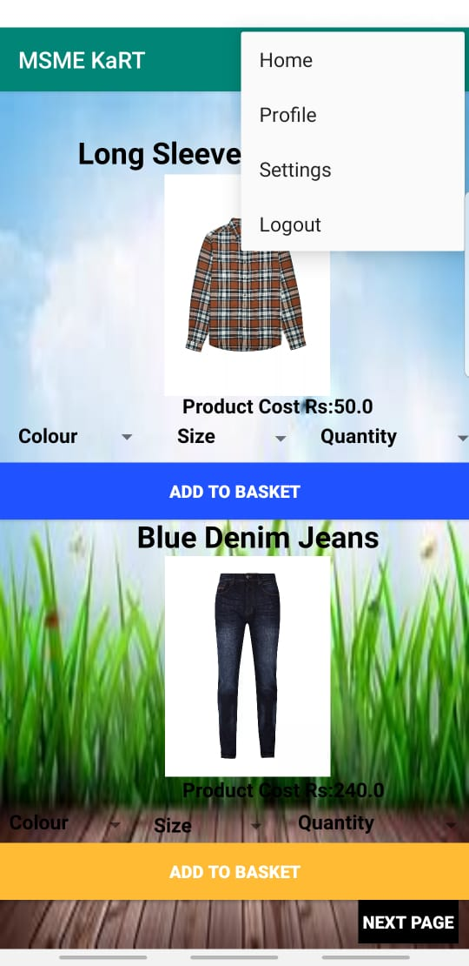
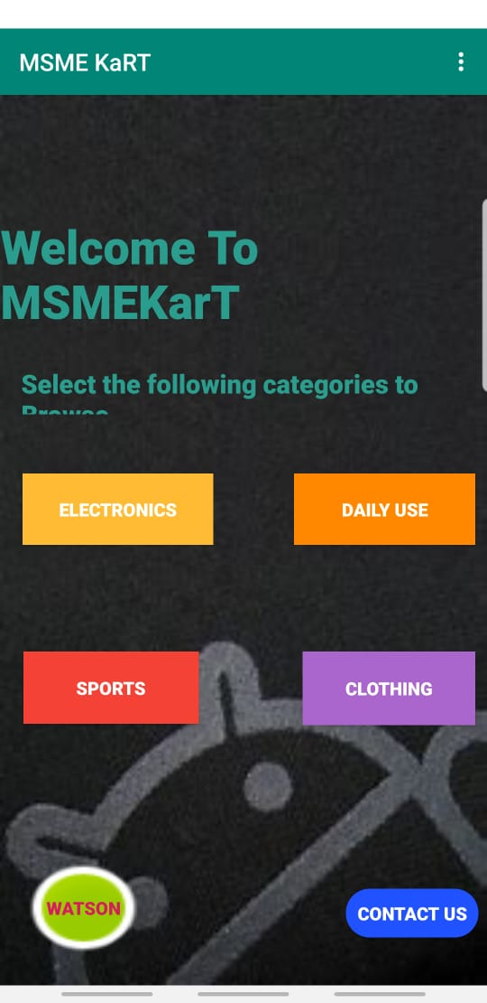
This is how the Homepage (Main Activity) looks. It has Various categories to choose from and a drop-down menu on the action bar that allows users to Logout , go to settings or profile.

Slide 10
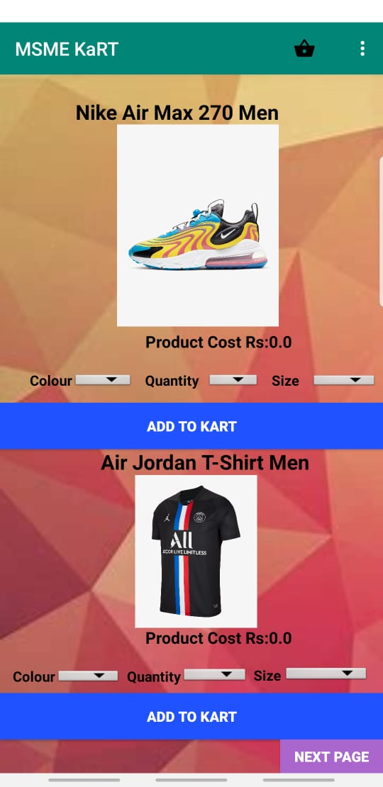
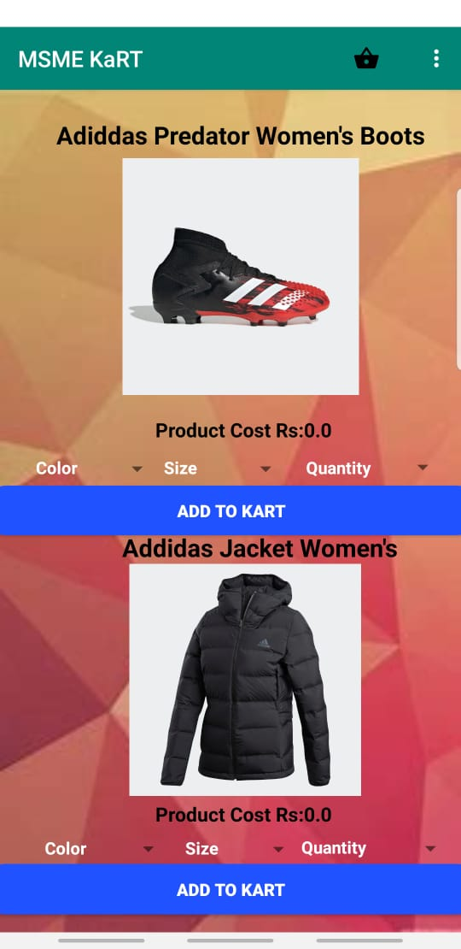
This is how the Sports and Outdoors Activity User Interface looks like. Customers can choose the color, quantity and size they would like for each product and then they can add it to the basket.

Slide 11
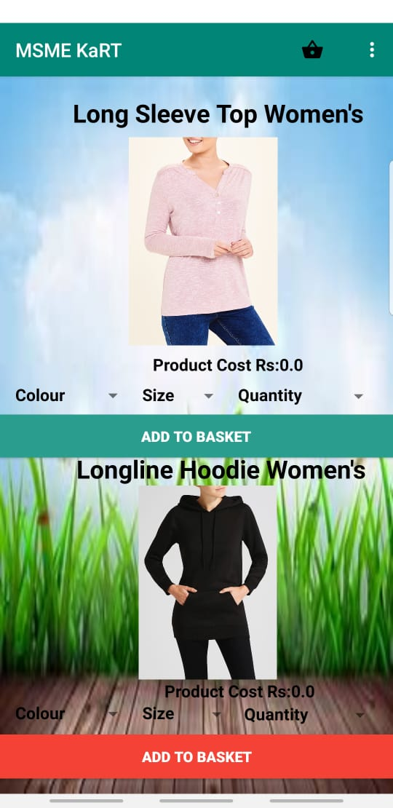
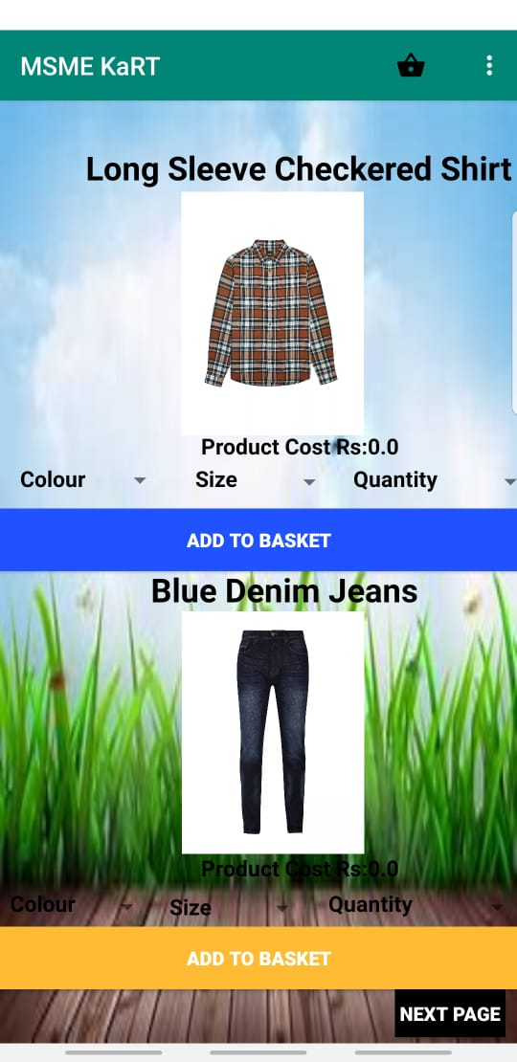
This is how the Clothing User Interface looks like. Same applies here, customers choose the color, size and quantity of the product(s) they would like to purchase then they can add it to the basket.

Slide 12
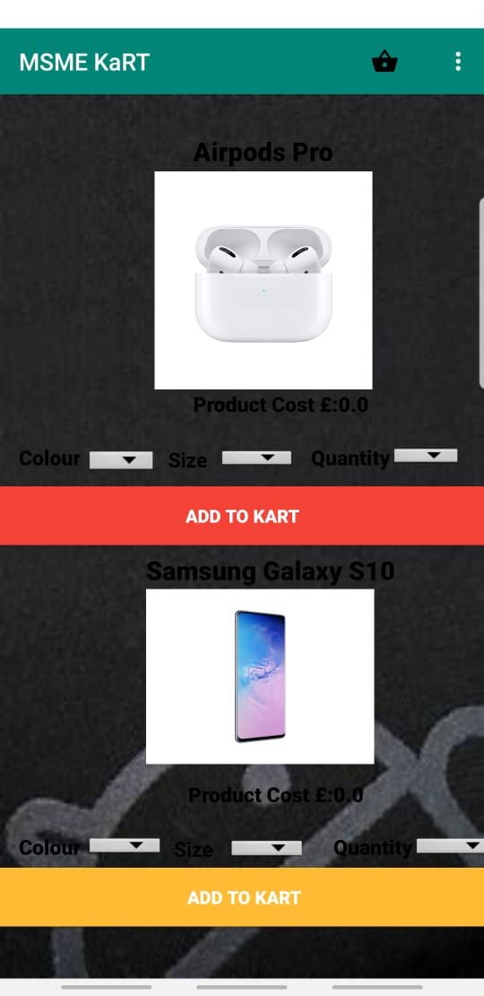
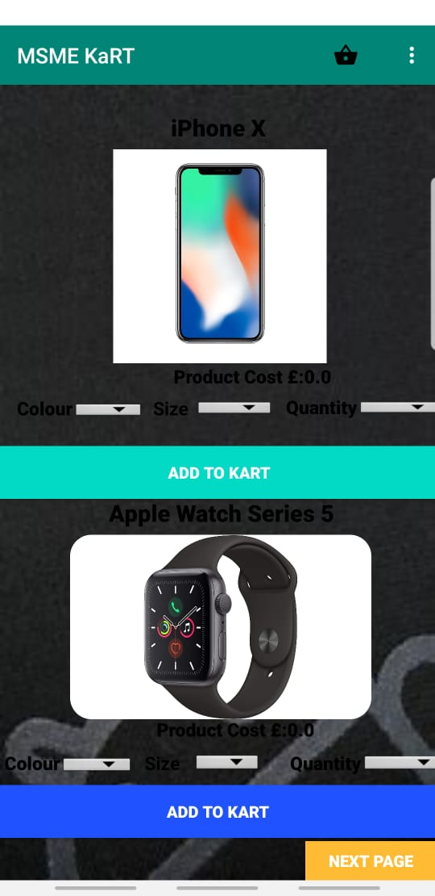
This is how the Tech Activity User Interface looks like. It is pretty minimalistic and simple to use. Customers can choose the color, size and quantity of the product they would like and then they can add the product(s) to the basket. Same applies to the next page of the tech activity

Slide 13
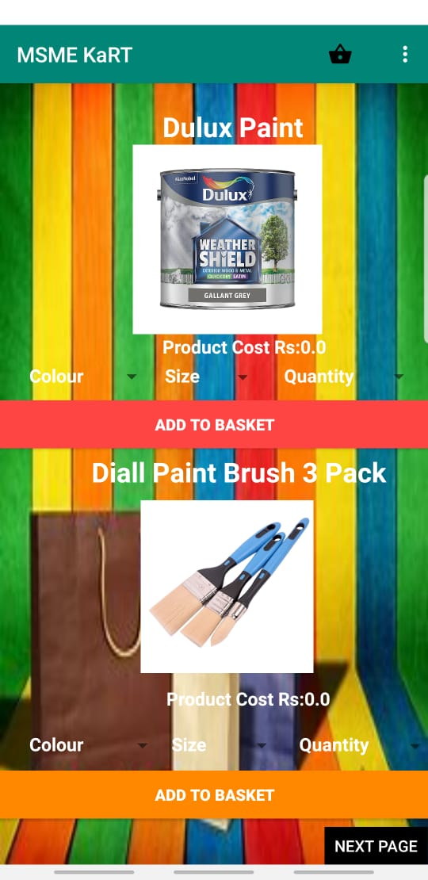
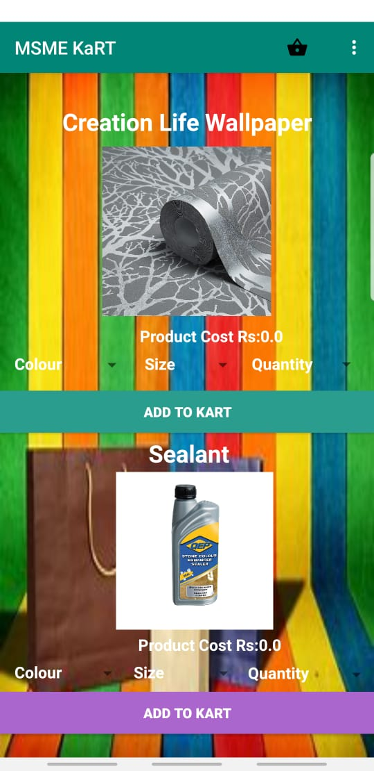
This is how the Daily Use Interface looks like implemented. It has the same functionality as the other categories.

Slide 14
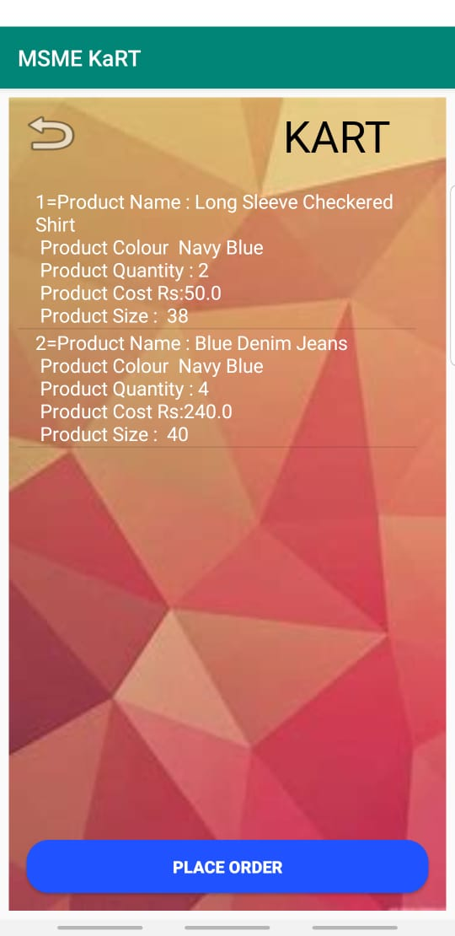
This is how the Kart looks like when customers add the products they wish to the Kart, this applies for all of the other categories, Tech, Clothing etc. If the customers are happy with the products in their basket, then they can go ahead and click the place order button which will take them to the Payment Activity.

Slide 15
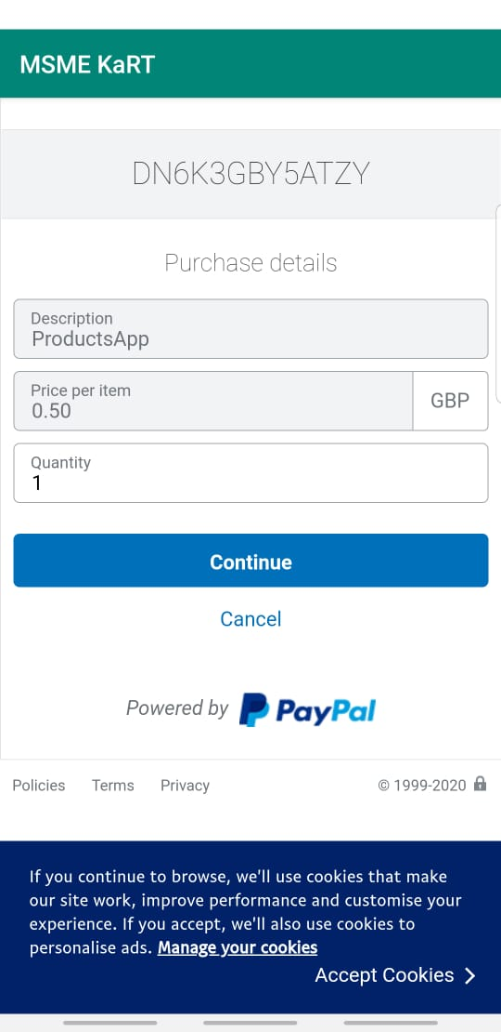
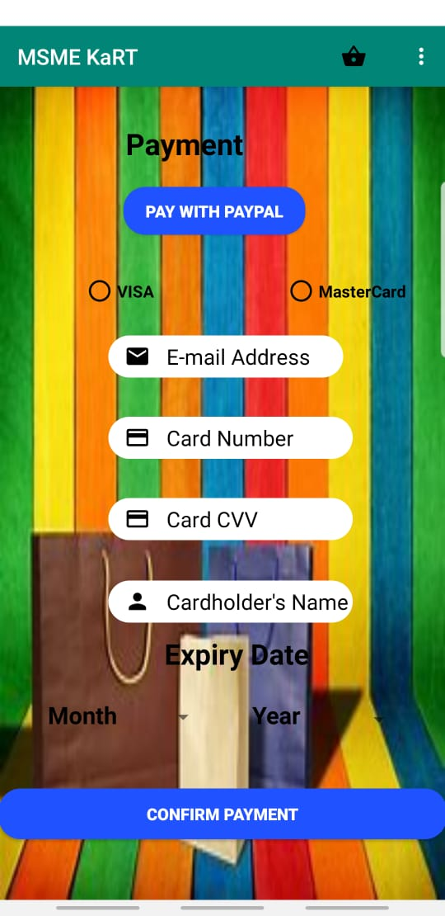
This is how the Payment Activity looks like implemented. After customers have chosen the products they would like to purchase, they are taken to this activity in order to purchase the products. Customers have the option to pay with PayPal if they don’t have VISA or MasterCard. After the payment process is successful, the customers will receive a confirmation email sent to them saying that the order has been successful

Slide 16
Complaints
Customers that are experiencing problems with the application can submit a complaint by filling out the form above. The details of the customer and the corresponding complaint will get stored in a back-end SQLite Database in which it will be used in order to see what is wrong and the problem will be taken into consideration for future updates.

Slide 17
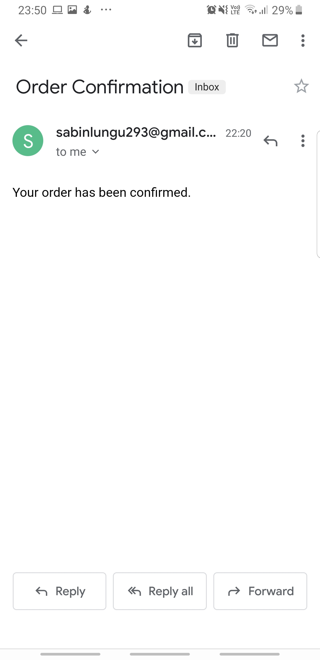
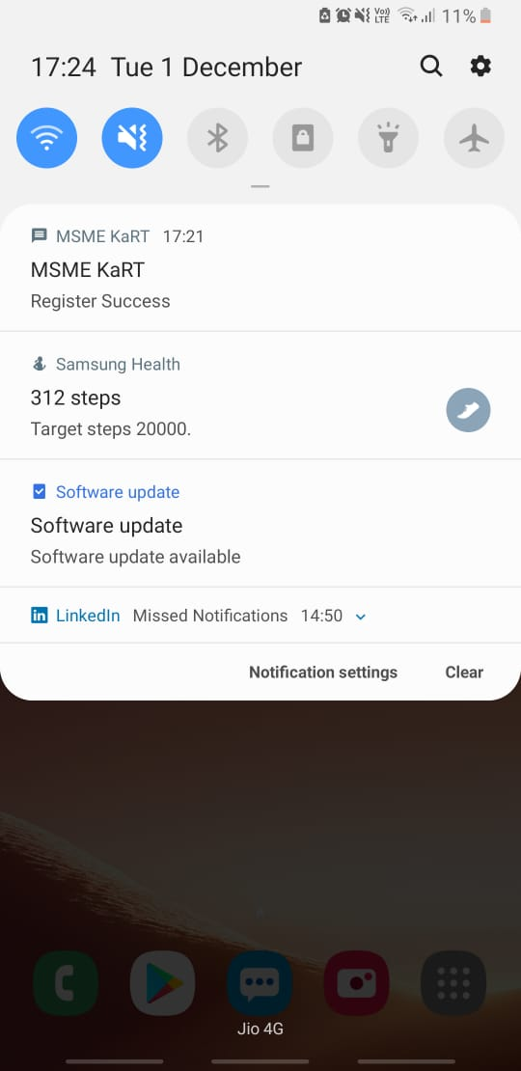
Push Notifications: - A push notification is a message that pops up on a mobile device. App publishers can send them at any time; users don't have to be in the app or using their devices to receive them. ... Push notifications look like SMS text messages and mobile alerts, but they only reach users who have installed your app. In our app we have used Push notification to notify user that whether their account has been registered or not , we have also implemented payment Invoice which will be received when user has successfully ordered.

Slide 18
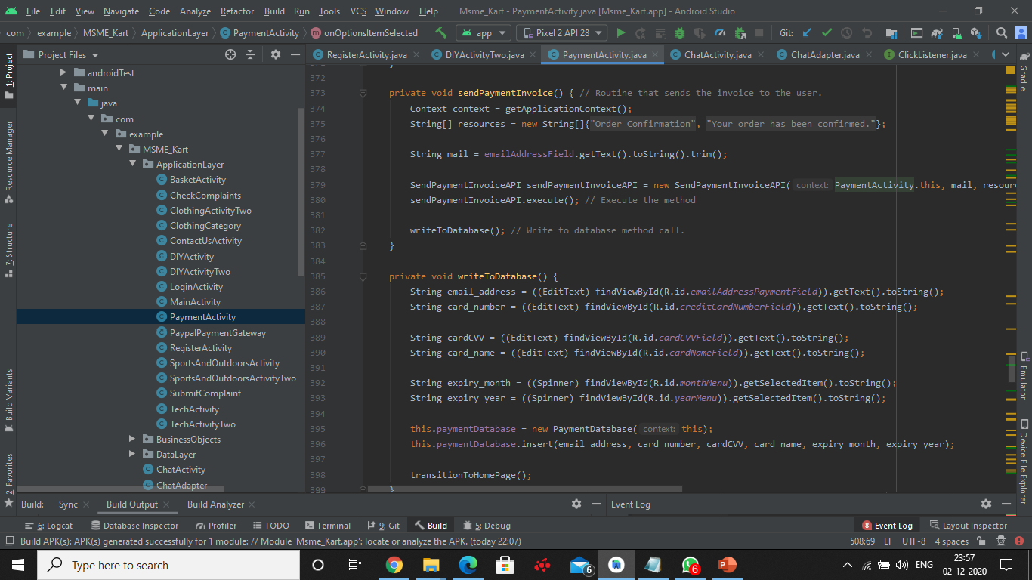
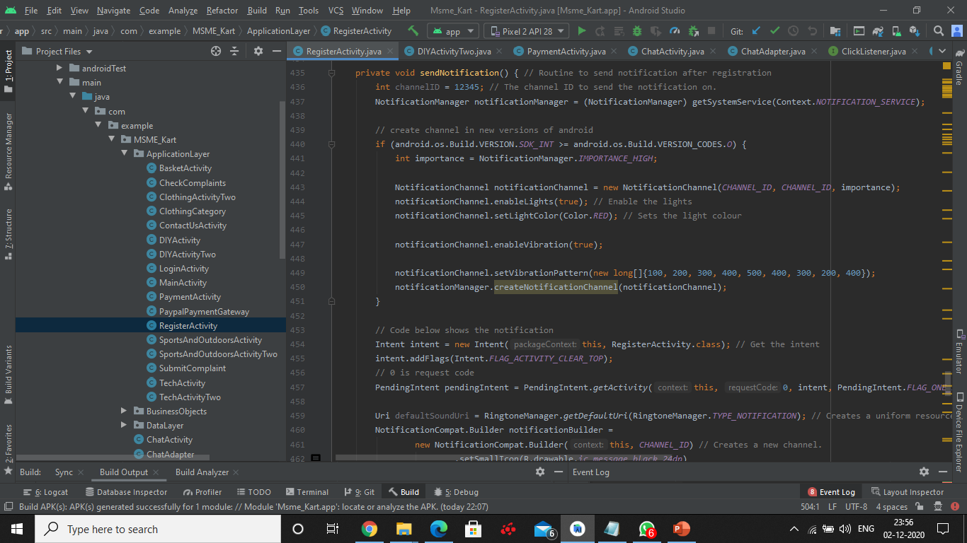
Implementation of Notification and payment Invoice

Slide 19
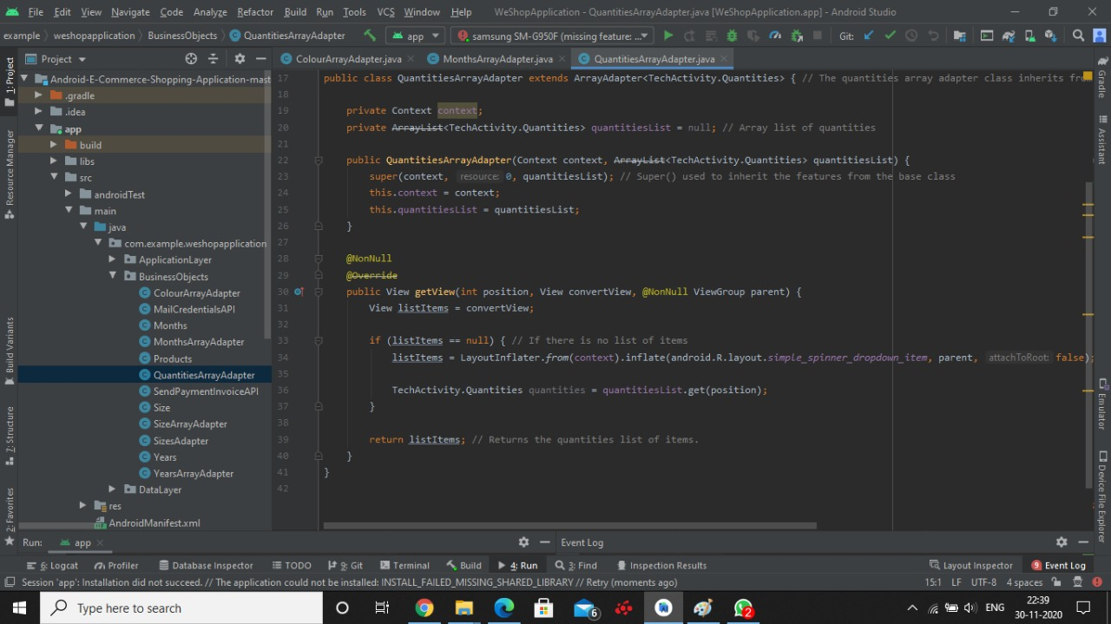
Working with adapters: - In Android, Adapter is a bridge between UI component and data source that helps us to fill data in UI component. It holds the data and send the data to an Adapter view then view can takes the data from the adapter view and shows the data on different views like as QuantitiesArrayAdapter, MonthsArrayAdapter, ColourArrayAdapter etc. Its is because of these adapters we are able to show Quantities, Colour , Size and Months in our application

Slide 20
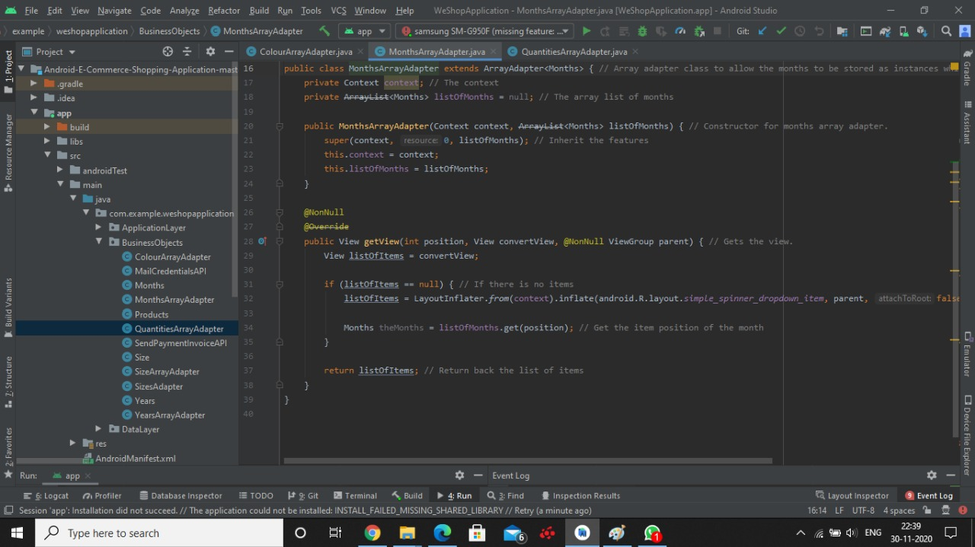
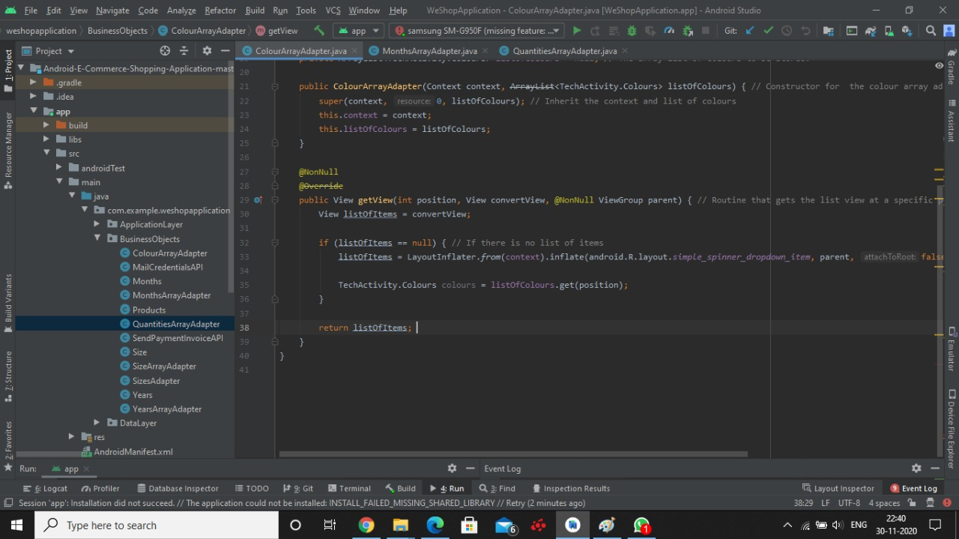
Some more Adapter representation in android studio

Slide 21
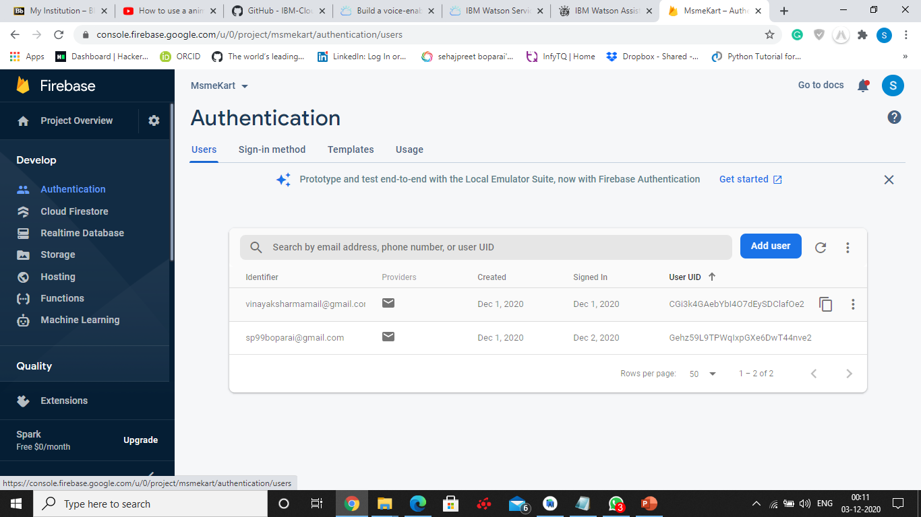
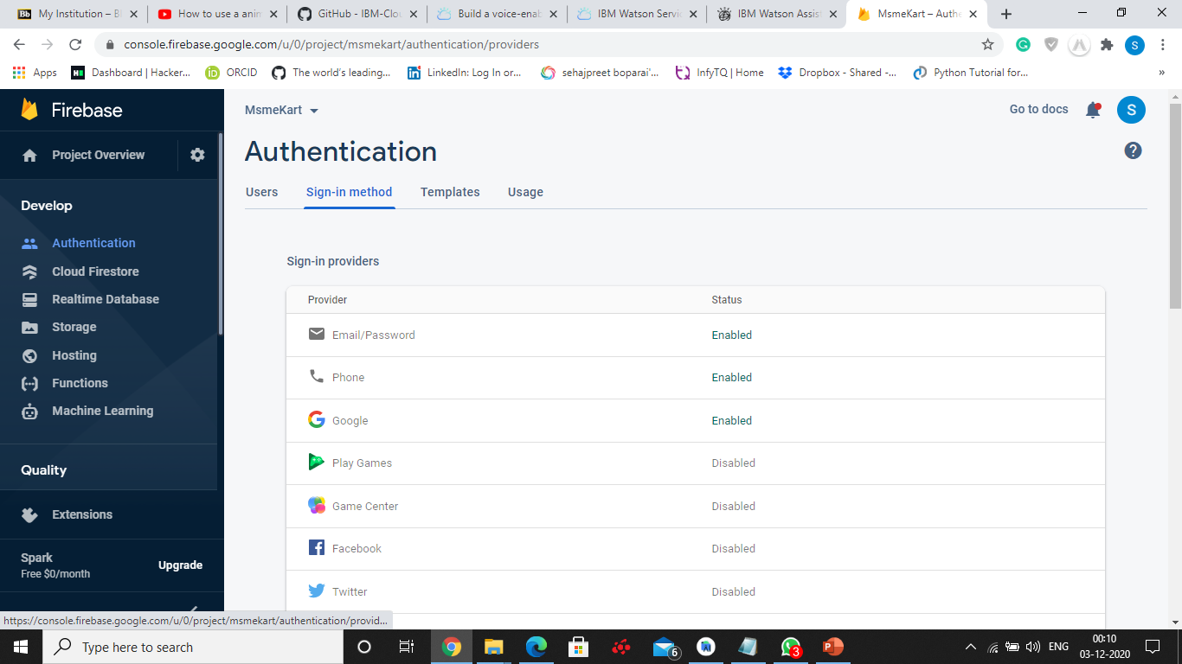
Administering and Testing for Credentials Validation towards User authentication. In our project MSMEKart. We have used Oath 2.0 based authentication. In which a Unique token is given to user when they register their email id and then the user can use that email to login. Steps: Implement the Firebase AUTH API Go to cloud console in Firebase and enable authentication through Email/password. Write code for Authentication in your Android Studio. Authentication completed

Slide 22
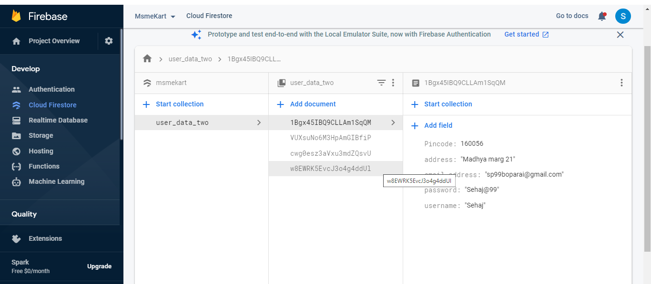
User Data Storage We have implemented CloudFirestore in our firebase console to store the user information like address and email.

Slide 23
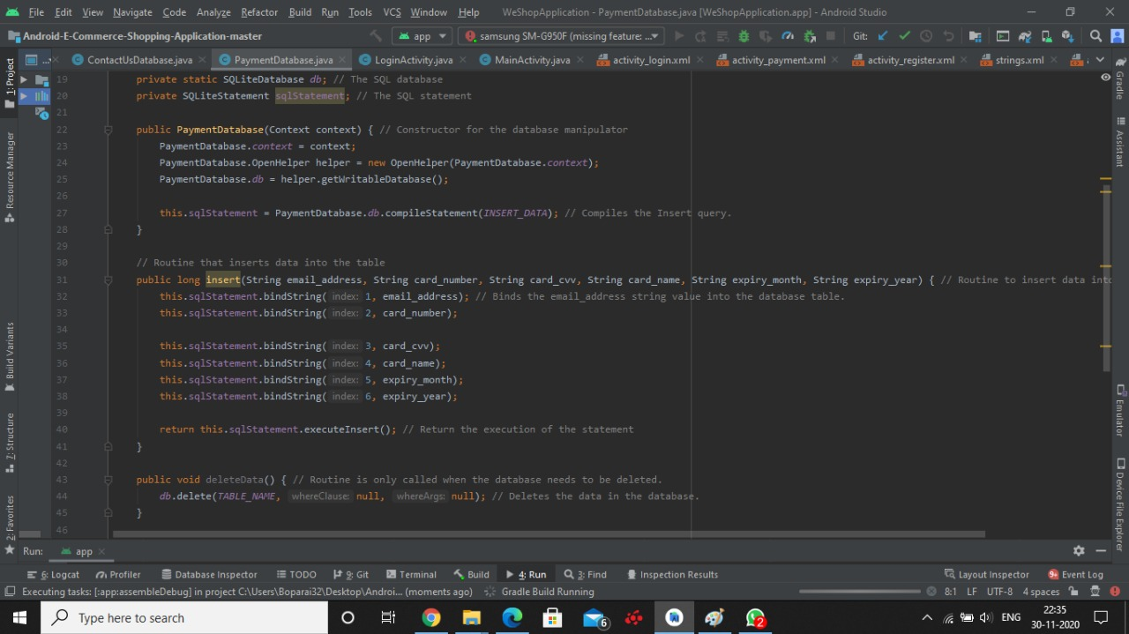
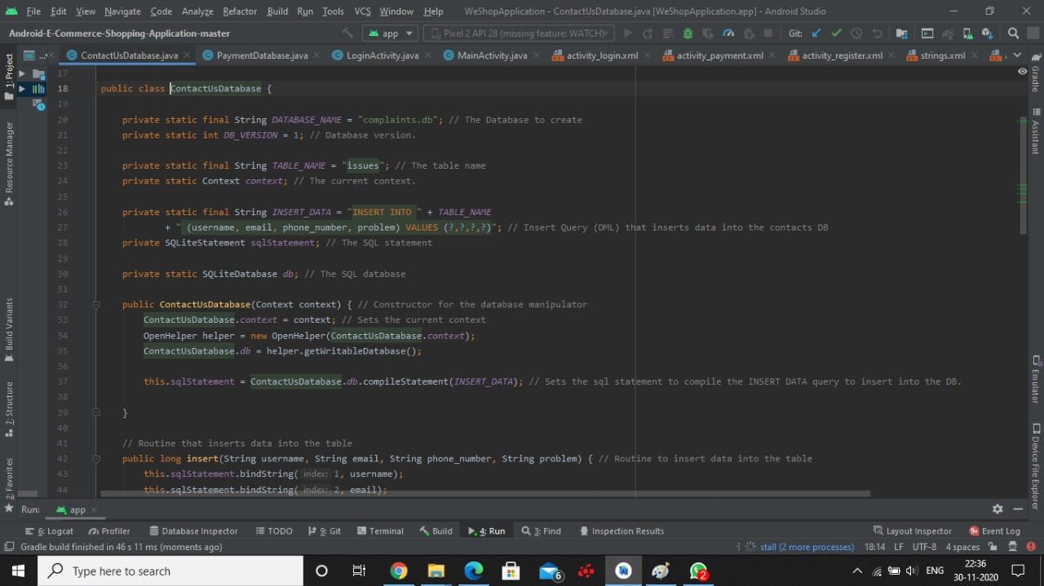
In our app we have implemented the SQL LITE database for payment and Customer complaint. So basically what happens is that when a customer is making a payment the information like card number and transaction details are stores in the sql lite database so if user what's to review their order it can be done easily

Slide 24
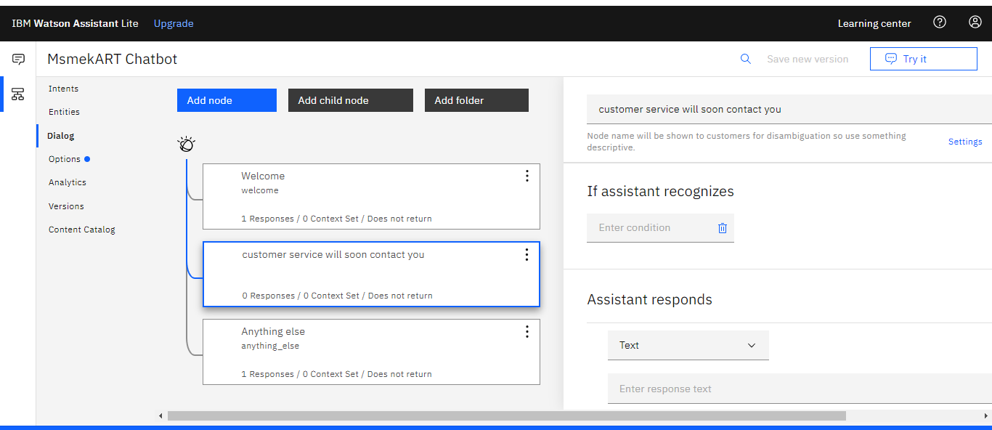
IBM Watson Implementation

Slide 25
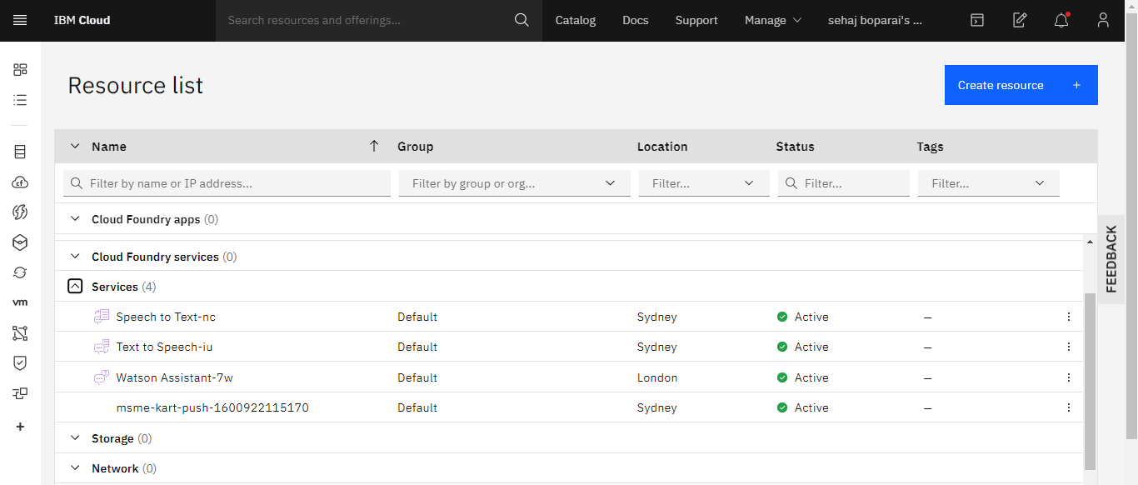

Slide 26
Future Scope
Tracking of order
Improving assistant
Improving the kart functionalites.

Slide 27
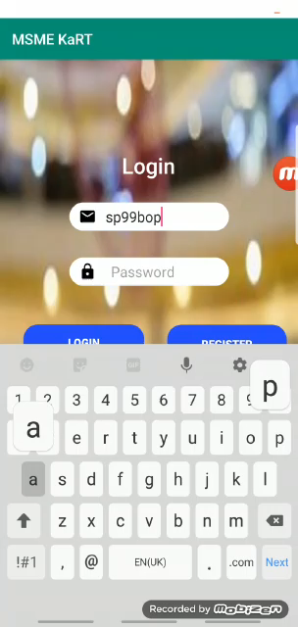

Slide 28
Thank You
Project –MSME Kart
Member's –
Sehajpreet Boparai
Utsav Bhardwaj
Bhavesh Joshi

